Slide 1
Imperialumab Sales Booster Recommendations
Members of Group 4:
Yitong Liu | 01625757
Faiz Fablillah | 01525542
Mingming Zhu | 01548939
Isabella Li | 01547310

Slide 2
Presentation Outline
Summary
Business problem overview
Summary of Analysis Approach and hypothesis
KPIs
Results of hypothesis analysis
Recommendations
Summary of Findings
Strengths & Limitations

Slide 3
Summary
Project Objective: Analyse sales and marketing data of Imperialumab drug and its competitor (Kingsumab & Uclumab) and provide recommendations to MD to increases sales of drug.
Available Dataset:
Imperialumab Sales: Sales data ($Mn) from Mar-2017 to June-2019.
Competitor’s Sales: Sales data ($Mn) of competitors kingsumab and uclumab.
Imperialumab marketing data: Marketing data about face 2 face detailing, medical education, e-mails and hard mails sent in all regions of UK.
Competitor’s marketing data: Marketing data of competitors in all regions of UK.
After detailed analysis of sales and marketing data was performed:
We provided list of recommendations to be taken into considerations regarding marketing.
We also provided list of recommendations about which are strong points of Imperialumab to highlight while doing face 2 face and medical education marketing.

Slide 4
Business Problem Overview
UK based pharmaceutical company launched drug named imperialumab for treatment of pancreatic cancer on Mar-2017. It’s competitor also launched drugs named Kingsumab and Uclumab for treatment of same disease on May-2018.
Imperialumab constantly saw growth in its sales till introduction of its competitors and then it seems to have stagnated due to fierce competition from Kingsumab who can cross Imperialumab sales in few months due to its fast growth rate.
Main objective of doing this exercise is to do detailed analysis on sales and marketing data of Imperialumab and its competitor. Once in-depth analysis is done, we have to suggest recommendations about how marketing should be performed to increases sales of Imperialumab further.
We also need to provide observations about trend of sales which can help in decision making..

Slide 5
Summary of Analysis Approach and hypothesis
Below is the high level approach that we took to analyze the data
Brainstormed potential hypothesis
Decided on hypothesis
Performed data cleaning
Performed data analysis
Evaluated hypothesis
Marketing Recommendations
List Of Hypothesis:
Kingsumab's growth will cross sales of Imperialumab in next 6 months.
Imperialumab has conducted highest face 2 face interview with doctors in all regions.
Imperialumab has performed highest number of Med Eds compared to Kingsumab and Uclumab.
Imperialumab has sent highest amount of unsolicited e-mails than Uclumab & Kingsumab.
Imperialumab has sent highest amount of hard mails in all regions.
List of Observations:
Imperialumab has highest sales till now which is ~3 times than Kingsumab and ~11 times than Uclumab.
Imperialumab seems to be leading market as of now with fierce competition from Kingsumab who started almost a year late.
Companies shows fast growth in initial 9-12 months and then stagnate.

Slide 6
KPIs
Sales ($Mn) : Sales per month in $Mn.
Marketing KPIs:
Face 2 Face Detailing: Face 2 Face detailing count per doctor per year in all regions.
Medical Education: Medical Education count per doctor per year in all regions.
Unsolicited e-mails: e-mails sent to each doctor per year in all regions
Hard Mails: Hard mails sent to each doctor per year in all regions.

Slide 7
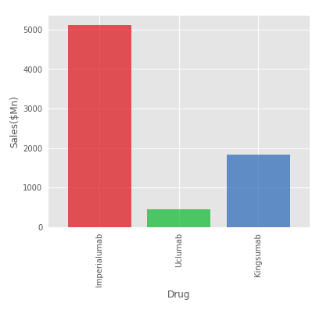
Results
Observation 1: Imperialumab has highest sales till now which is ~3 times than Kingsumab and ~11 times than Uclumab
Findings:
Sales done by Imperialumab(5.12 Bn Dollars) seems unchallenging and quite high compared to Uclumab(0.45 Bn Dollars) and Kingsumab(1.82 Bn Dollars).
Imperialumab has done ~3 times sales than Kingsumab and ~11 times sales than Ucluumab.
Kingsumab has done ~4 times sales than Uclumab.

Slide 8
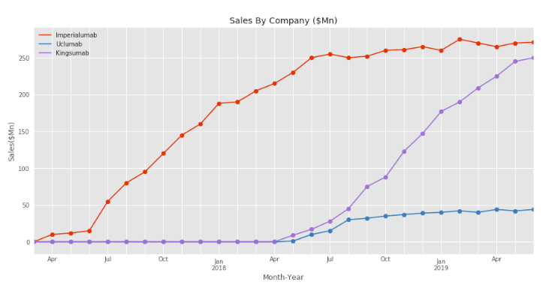
Observation 2: Imperialumab seems to be leading market as of now with fierce competition from Kingsumab who started almost a year late.
Findings:
Introduction of Uclumab & Kingsmab into competition on Jun-2018 immediately impacted sales of Imperialumab in Aug-2018.
Even though sales of Kingsumab which started almost 1 year 2 months late than Imperialumab is catching very fast.

Slide 9
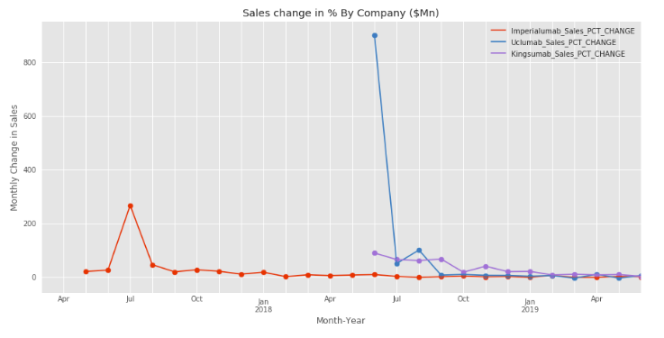
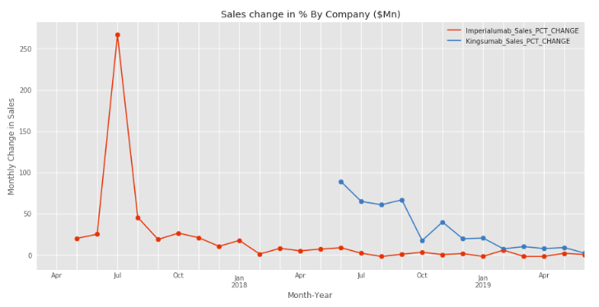
Observation 3: Companies shows fast growth in initial 9-12 months and then stagnate.
Findings:
After launch of Imperialumab, it saw peak growth in sales from June-2017 to July-2018. After that it declined or even growth almost stayed constant.
Uclumab saw tremendous initial growth but then it declined and almost stayed constant after 3 months of launch.
Kingsumab has shown quite good growth after launch for almost 8 months and then it stayed constant.

Slide 10
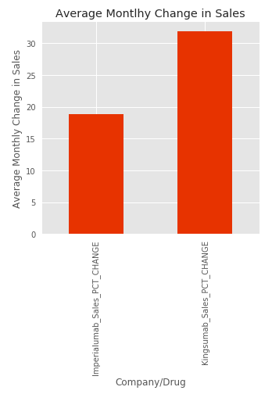
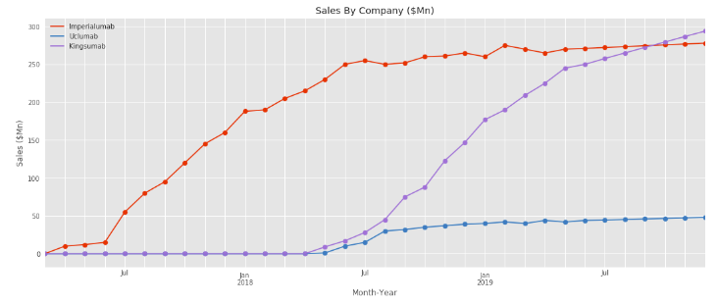
Hypothesis 1: Kingsumab's growth will cross sales of Imperialumab in next 6 months.
Findings:
Average percentage change in sales of Imperialumab overtime is around +(~19%) whereas its around +(~32%) for kingsumab.
Linear Interpolation of Sales data for next 6 months from Jul-2019 to Dec-2019 shows that Kingsumab will cross sales of Imperialumab in next 4 months based on its current growth rate.

Slide 11
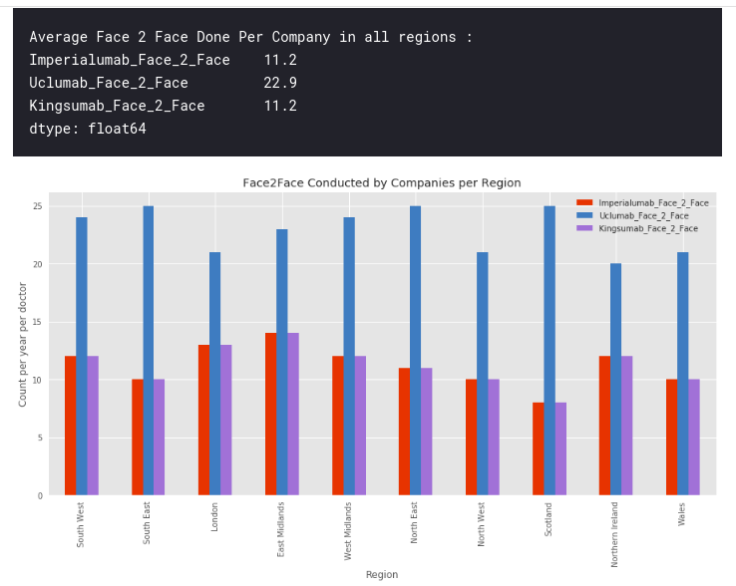
Hypothesis 2: Imperialumab has conducted highest face 2 face interview with doctors in all regions.
Findings:
It's clearly visible that Uclumab has conducted almost more than twice the size of Face 2 Face interview than conducted by Imperialumab and Kingsumab in all regions.
Imperialumab and Kingsumab has conducted same amount of face 2 face in all regions.

Slide 12
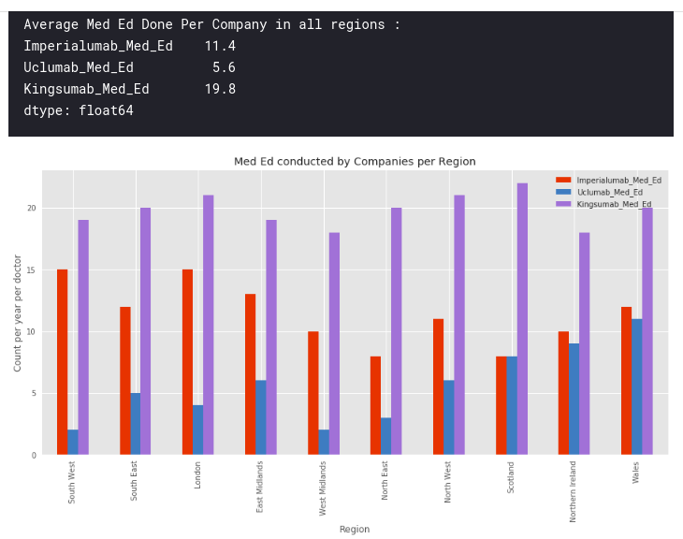
Hypothesis 3: Imperialumab has performed highest number of Med Education sessions compared to Kingsumab and Uclumab.
Findings:
Kingsumab has conducted almost ~0.5-2.0 times med ed compared to Imperialumab in all regions
Med ed conducted by Uclumab are quite less compared to Kingsumab in all regions
Med ed performed by Uclumab and Kingsumab are almost same in Scotland, Northern Ireland and Wales regions.

Slide 13
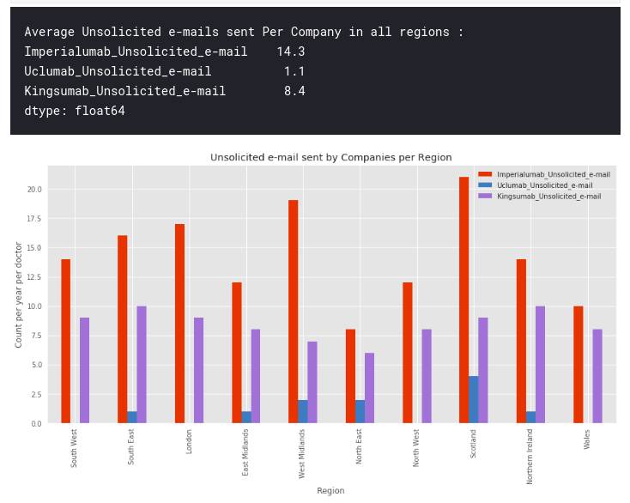
Hypothesis 4: Imperialumab has sent highest amount of unsolicited e-mails than Uclumab & Kingsumab.
Findings:
Unsolicited e-mails sent by Imperialmab is quite high than Uclumab and Kingsumab.
Unsolicited e-mails sent by Imperialumab is almost ~0.5-2.0 times than that of Kingsumab.
Unsolicited e-mails sent by Uclumab are highest (5) in Scotland whereas it has sent nearly 1-2 emails in other regions and no mails in South West, London, North West & Wales.

Slide 14
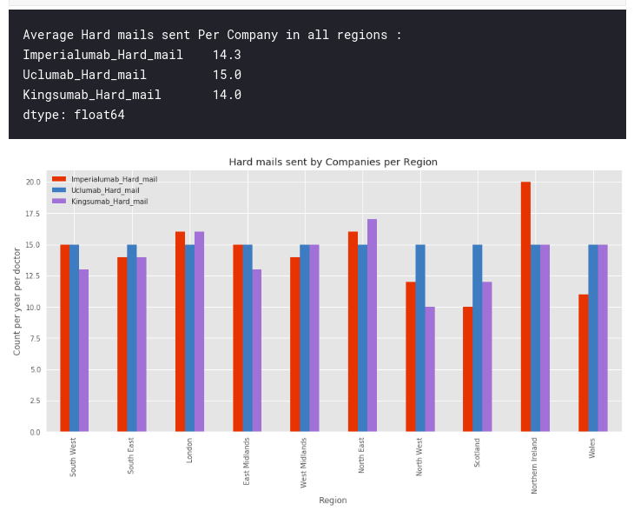
Hypothesis 5: Imperialumab has sent highest amount of hard mails in all regions.
Findings:
Hard mails sent by all companies are almost same in all regions with exceptions like Northern Ireland, North West, Scotland and Wales.
Imperialumab has highest amount of hard mails in Northern Ireland.
Uclumab has sent same 15 hard mails in all regions.
Average hard mails sent by each company is ~14-15.

Slide 15
Recommendations
Optimal value of face 2 face detailing for best result is 12 per doctor per year which is less in South East, North West, Scotland and Wales regions whereas London and East Midlands has crossed this limit. Try to bring average value to 12 in all regions.
Medical Education’s optimal value is 20 per doctor per year. Imperialumab’s med ed on average is 11 which should be brought up to 20 as it seems to have boost sales of Kingsumab.
Imperialumab should decrease average value of unsolicited e-mails sent from 14 to 9 per doctor per year in all region. Don’t spam doctors as it might backfire sales.
Imperialumab has already sent 15 hard mails on average per doctor per year with exception of Northern Ireland sending more than optimal and North West, Scotland & Wales sending less than optimal. Optimize hard mails sent in these regions.

Slide 16
Recommendations (Contd.)
Inform sales representatives to make doctors aware of benefits of using Imperialumab compared to competitions (Kingsumab & Uclumab) during face-2-face detailing and medical education:
Ask sales representative to highlight attributes like efficacy, side effect profile, formulation and safety profile of Imperialumab as it easily beats its competitor in these areas.
Patent of Imperialumab expires in 2025 whereas Kingsumab expires in 2021 which will create market for cheap alternatives which gives company 2.5 years to earn profit.
Cost of living healthy life (QALY) given Imperialumab is ~28k Pounds per year whereas same cost with Kingsumab is 28.5k pounds and with Uclumab is around 29k pounds. This can be highlighted as well by representative to doctors/retailers during face-2-face and med eds.

Slide 17
Summary of findings
Sales done by Imperialumab(5.12 Bn Dollars) seems unchallenging and quite high compared to Uclumab(0.45 Bn Dollars) and Kingsumab(1.82 Bn Dollars).
Average percentage change in sales of Imperialumab overtime is around +(~19%) whereas its around +(~32%) for kingsumab.
Average face 2 face done by Imperialumab, Kingumab and Uclumab are ~11, ~11 and ~22 respectively per doctor per year in all regions.
Average med ed done by Imperialumab, Kingsumab and Uclumab are ~11, ~20 and ~5 respectively in all regions.
Average unsolicited e-mails sent by Imperialumab, Kingumab and Uclumab are ~14, ~8 and ~1 respectively in all regions.
Average hard mails sent by Imperialumab, Kingumab and Uclumab are ~14, ~14 and ~15 respectively in all regions..
Cost of using Kingsumab is ~1.78% costly than Imperialumab and Uclumab is ~3.57% more costly than Imperialumab per year which can significantly impact pockets of customers if drugs are used for years.

Slide 18
Strengths & Limitations
Strengths:
All results are shown with visual proofs. Bar chart shows clear comparisons per region of companies which helps in making decision better.
Interpolation gives idea about when Kingumab sales will cross Imperialumab if same condition continues and Imperailumab takes no measures.
Percentage change in sales on monthly basis gives exact idea about growth.
Limitations:
Interpolation is done for next 6 months. It's not possible that all companies will move into this direction only. It’s one of predictions using linear formula.
Sales comparison seems in favour of Imperialumab because it seems to have started selling drug almost 1 year back then Uclumab and Kingsumab.
Marketing data analysis is based on count per doctor per year in all region and no other data is given.

Slide 19
Thank you for listening, any questions?

